Slide 1
Natural Language Processing - Scraping and Modeling
Chris birch

Slide 2
OBJECTIVE
Scrape Reddit for posts
Format / Organize Data
Preprocess
Model
Interpret
Conclusions

Slide 3
Collect / Clean / Organize
Reddit API
Export to CSV
No nulls
Target = ‘subreddit’
Features = ‘title’

Slide 4

Preprocessing
{ Parameters }
CountVectorizer
Vectorization – “The general process of turning a collection of text documents into numerical feature vectors.”
Tokenization – each word becomes a feature (token)
Counting – number of occurrences of each token
Normalizing – weighting with diminishing importance tokens that occur in the majority of samples
TF-IDF
Term Frequency Inverse Document Frequency
STOP WORDS

Slide 5
New Study Suggests Scientists and Researchers Use Brain more than Most People
Google Unveils New Use for Facebook and People are Going Wild

Slide 6
“Poor Selection of Subreddits”

Slide 8
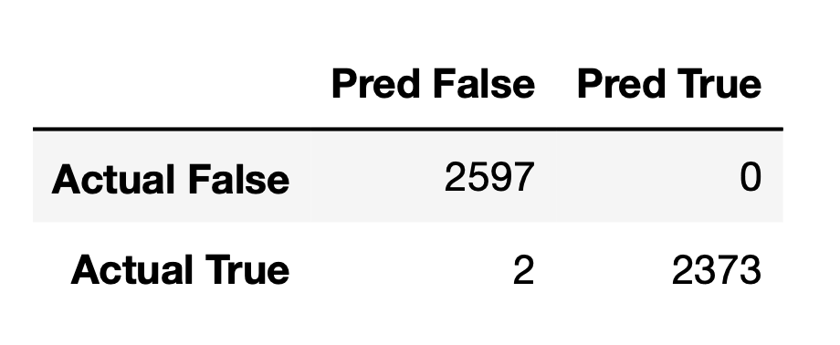
Modeling Logistic Regression
Accuracy: 99.96%
Specificity: 100%
Sensitivity/Recall: 99.91%
ROC AUC: 99.96%

Slide 11
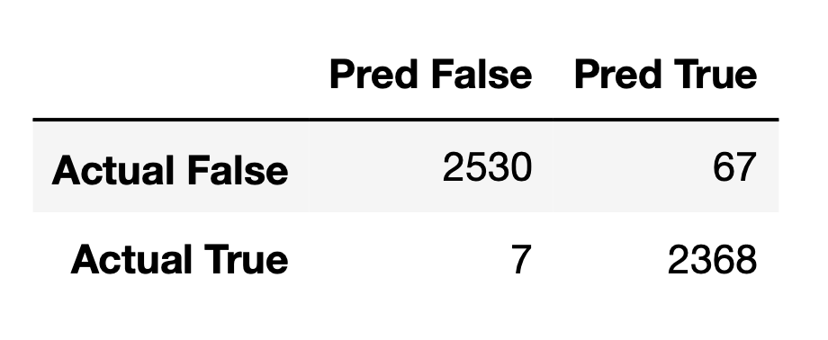
Modeling Multinomial Naïve Bayes Classifier
Accuracy: 98.51%
Specificity: 97.42%
Sensitivity/Recall: 99.70%
ROC AUC: 98.56%

Slide 13
Model Selection
Tuning Parameters
Data
Interpretation
Conclusion
Recommendation

